Slide 1
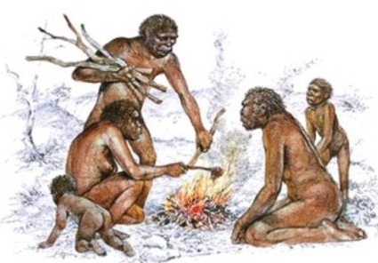
Human Ancestors: Homo habilis, Homo erectus
Habitat and Behaviour
Fossil Record
Anatomical Features

Slide 2
Date: | Human Biology Year 12 ATAR
Do Now Hand in review worksheet Lesson Agenda 1: Do Now 2: Human Ancestors – Homo habilis, Homo erectus 3: Lesson summary and windup Suggested Study Read through today’s notes and textbook section Complete review worksheet, then mark and correct using the answer key on Connect (compulsory). NEXT LESSON Homo heidelbergensis Homo neanderthalensis Homo sapiens | Learning Aims Describe the habitat, lifestyle, time of existence and location of Homo habilis Describe the location of major fossil finds for H. habilis Describe anatomical features of H. habilis Describe habitat, lifestyle, time of existence and locations of Homo erectus Briefly outline the fossil record of H.erectus Describe aspects of the anatomy of H.erectus and how this differs from earlier and later hominins. Describe major migration patterns for H.erectus
 | Key Vocabulary Oldowan Acheulean Homo

Slide 3
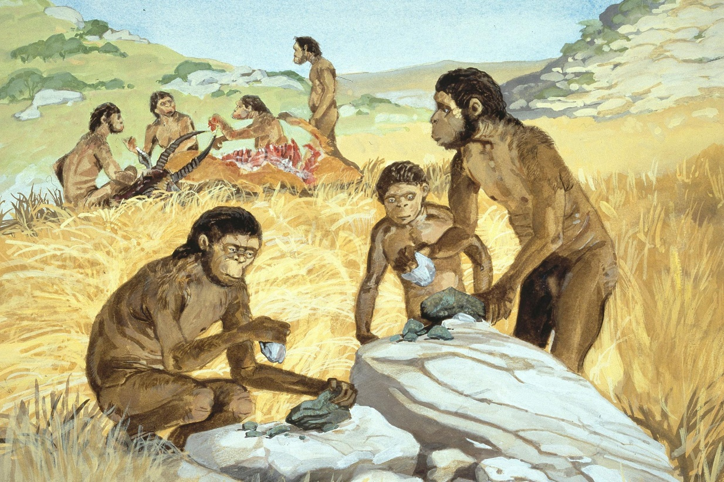
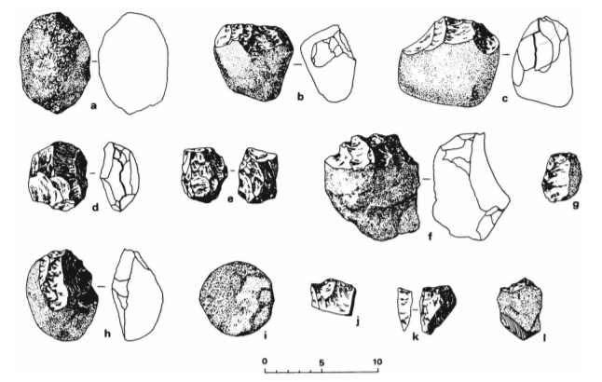
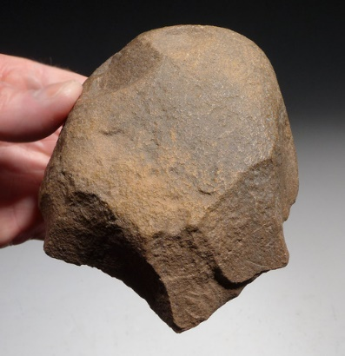
Homo habilis: “Handy Man” – Overview
Likely to have evolved from Australopithecus.
Lived 2.4 million to 1.4 million years ago in East Africa.
May have been a direct ancestor of humans, or on a different “branch” of the evolutionary tree.
Bipedal
Lived in family groups.
Probably spent daylight hours on the ground, may have slept in trees for safety.
Crafted stone tools “Oldowan choppers” – may have been the first to do so.
Evidence of animal bones being chopped up to get to marrow.
Tooth enamel studies suggest varied diet including meat.
Learning Aim: Describe the habitat, lifestyle, time of existence and distribution of Homo habilis

Slide 4
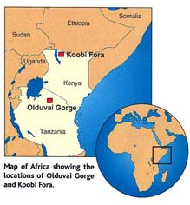
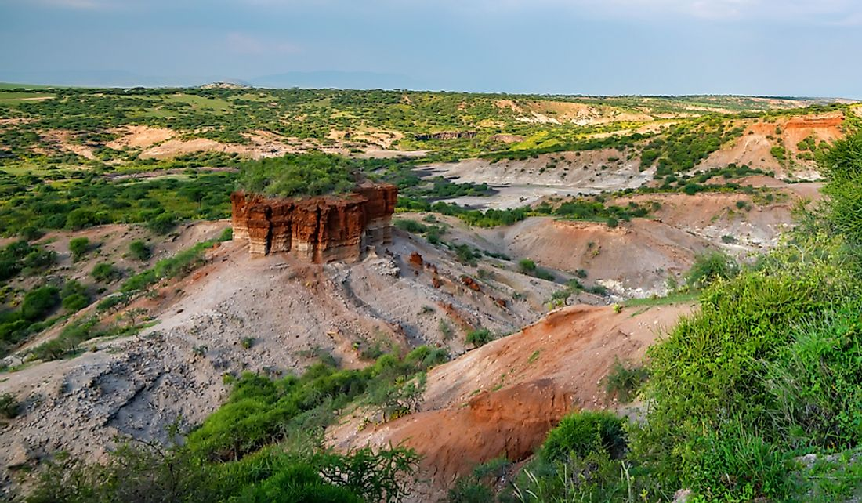
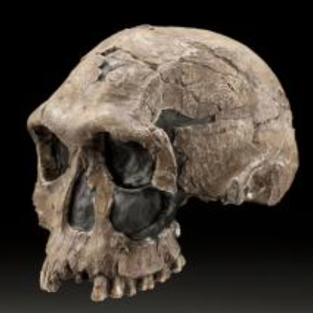
Homo habilis – Fossil Record
First find in 1964 – Dr Louis Leakey and team
Found jaw, two cranial fragments and other remains
Olduvai Gorge – east Africa
Dated at 1.75 million years BP
Named “Homo habilis” – “handy man” – tool making
Larger brain and smaller teeth than Australopithecus, with slightly more erect posture.
Further finds since then
Can be hard to classify between H. habilis and H. erectus
Learning Aim: Describe the location of major fossil finds for Homo habilis.

Slide 5
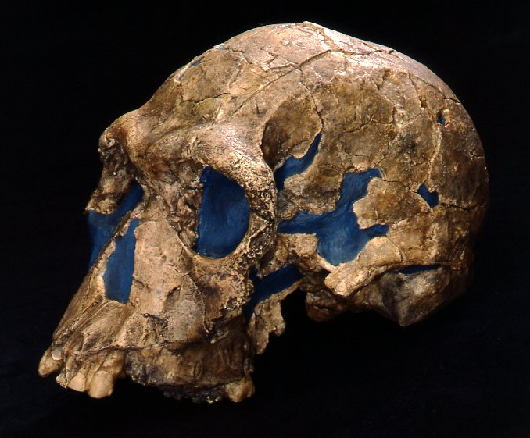
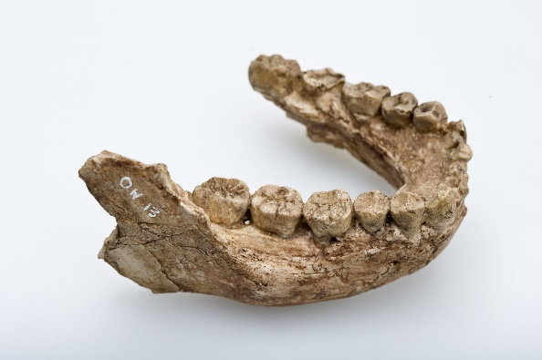
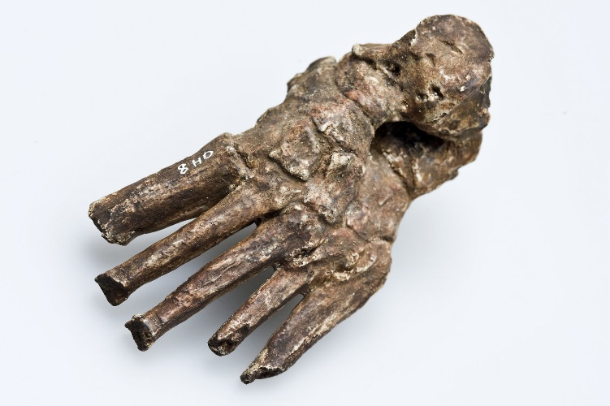
Homo habilis – Anatomy
Height – females 110cm, males 130cm
Cranial capacity around 610cc.
Rounder skull
Small brow ridge
Central foramen magnum
Moderate prognathism
Less jutting than Australopithecus, more than later humans
Increasingly parabolic dental arcade
Curved finger bones – powerful grip
Able to form precision grip
Fossils of feet show structure similar to modern humans
Learning Aim: Describe anatomical features of Homo habilis.

Slide 6
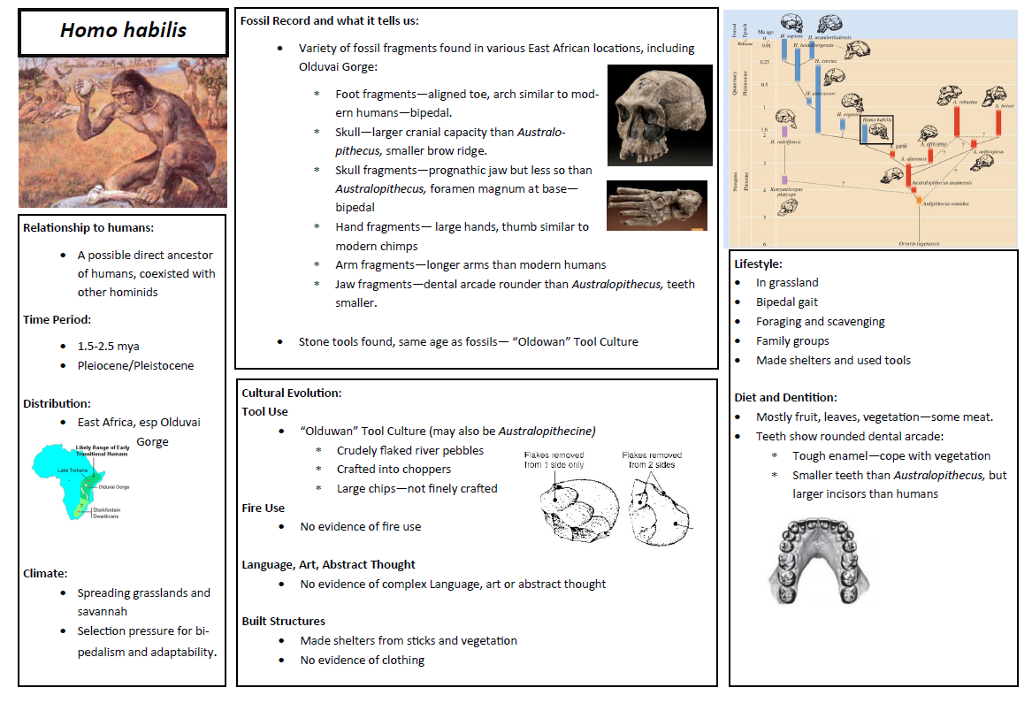

Slide 7
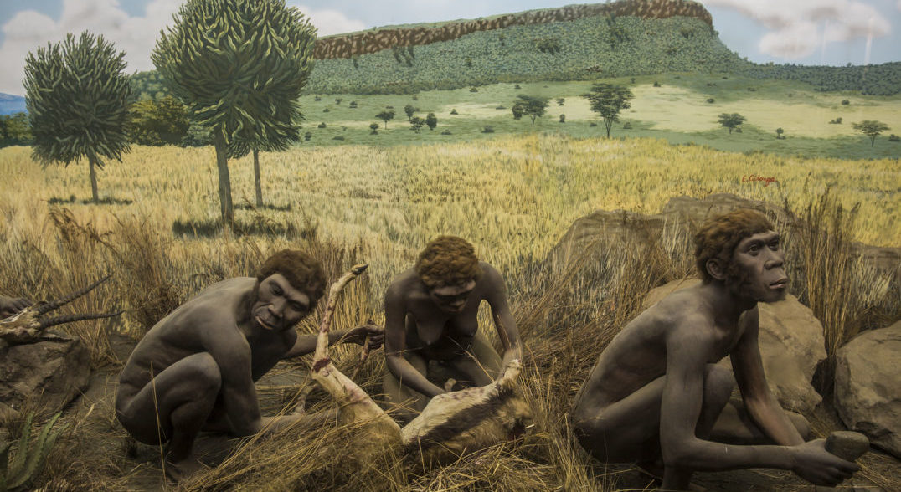
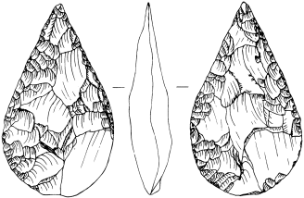
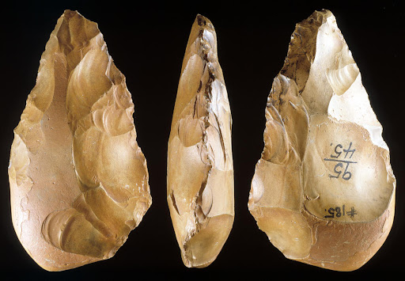
Homo erectus: “Upright Man” – Overview
Likely to have evolved from Australopithecus.
Lived around 1.9 mya to 100 000 years before present.
Evidence of adaptation and evolution within the species in this time.
Likely to be a direct ancestor of humans.
Can be difficult to decide if fossils are erectus or habilis.
Originally evolved in East Africa but migrated into Asia.
African Homo erectus sometimes called Homo ergaster.
Lived on ground, able to walk/run long distances
Evidence of fire use – hearths for cooking, warmth, and to deter predators
Made Acheulian stone tools.
Learning Aim: Describe the habitat, lifestyle, time of existence and distribution of Homo erectus.

Slide 8
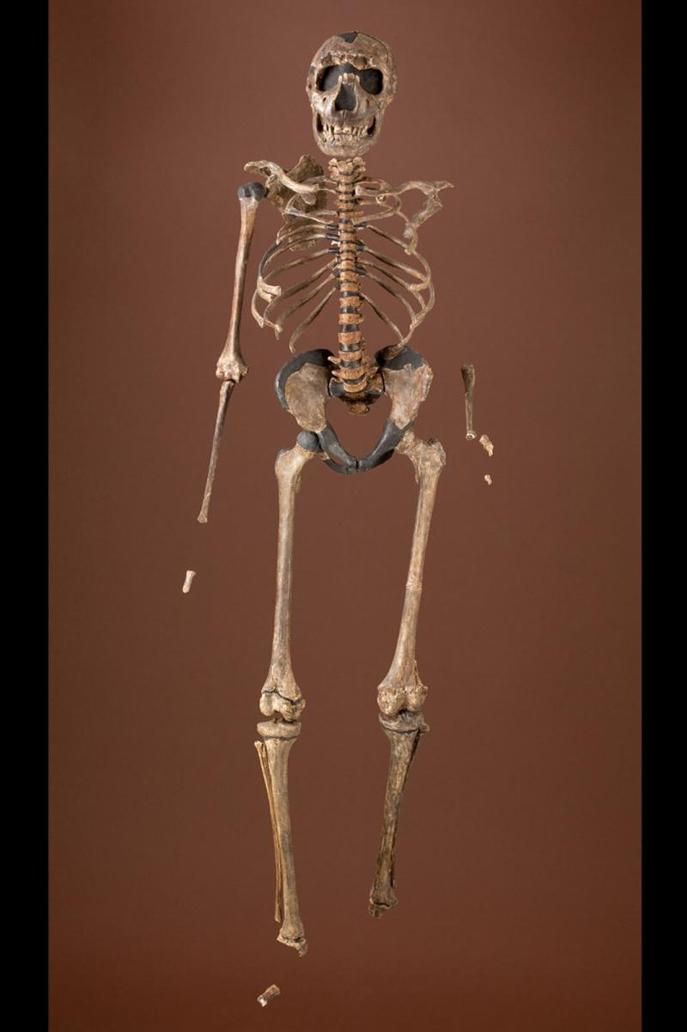
Homo erectus – Fossil Record
First fossils discovered in late 1800s – “Java Man” - Dubois
1927: “Peking Man” – H. erectus – Dr Davidson Black
Found in limestone cave south of Beijing
Brain larger, more modern features
Dental arcade shorter and rounded
Chin beginning to form, short, rounded jaw
Teeth very similar to modern humans – similar diet
Stone tools and hearth also found
Age 500 000 years ago – more recent than Java Man
Footprints found in 2009
At Ileret in Kenya
1.5 million years old
Indicate evolutionary origins in Africa
Human-like foot anatomy – big toe parallel, toes short, foot arch
Homo ergaster (often reclassified as African Homo erectus)
Learning Aim: Briefly outline aspects of the fossil record for Homo erectus.

Slide 9
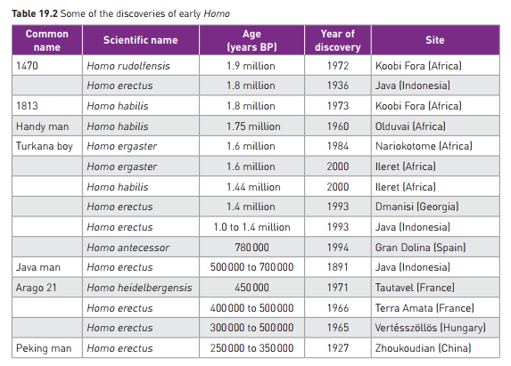
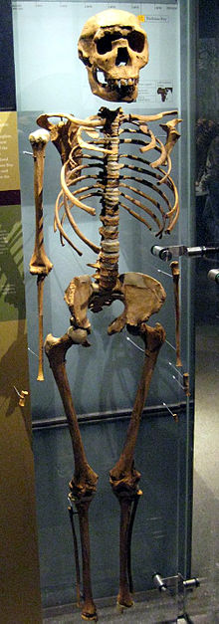
Learning Aim: Briefly outline aspects of the fossil record for Homo erectus.

Slide 10
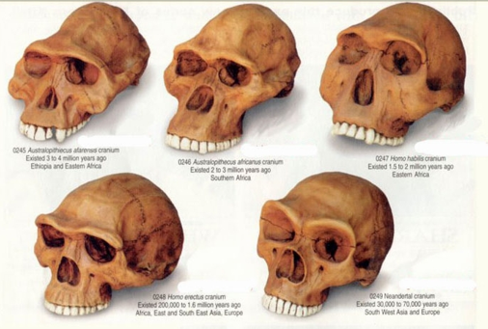
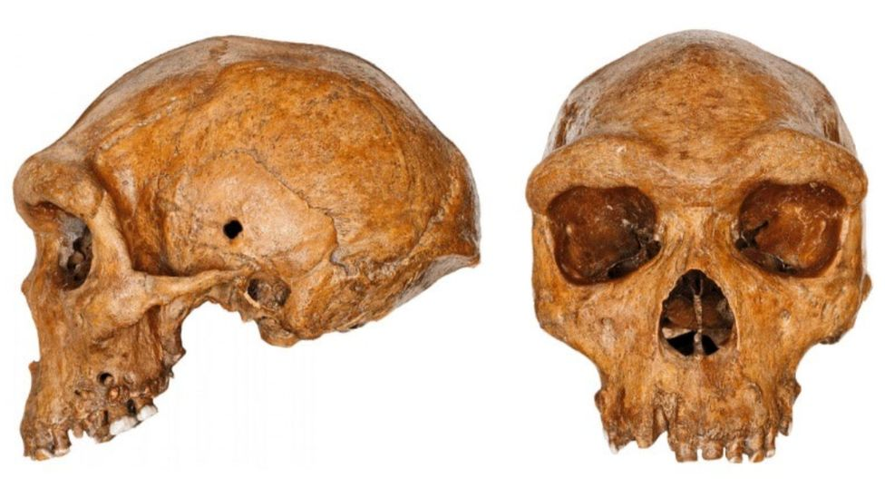
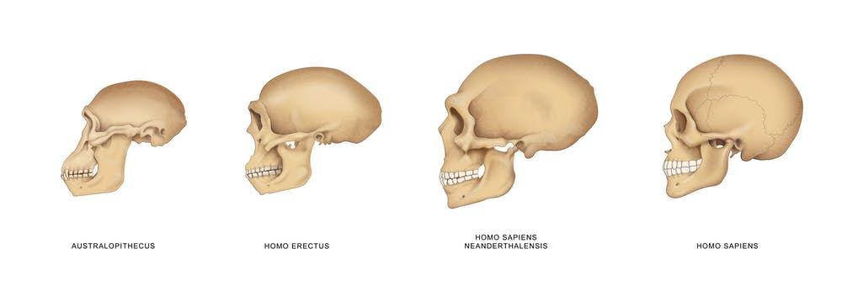
Homo erectus – Anatomy
Varied height 145-185 cm (similar to humans)
Stocky body, thick bones
Cranial capacity 1050cc
Much larger than previous hominins
Low, sloping forehead
Defined brow ridges
Dental arcade increasingly parabolic, reduced molar size
Less prognathism
Teeth very similar to modern humans – varied diet
Learning Aim: Describe aspects of the anatomy of H.erectus and describe how this differs from earlier and later hominins.

Slide 11
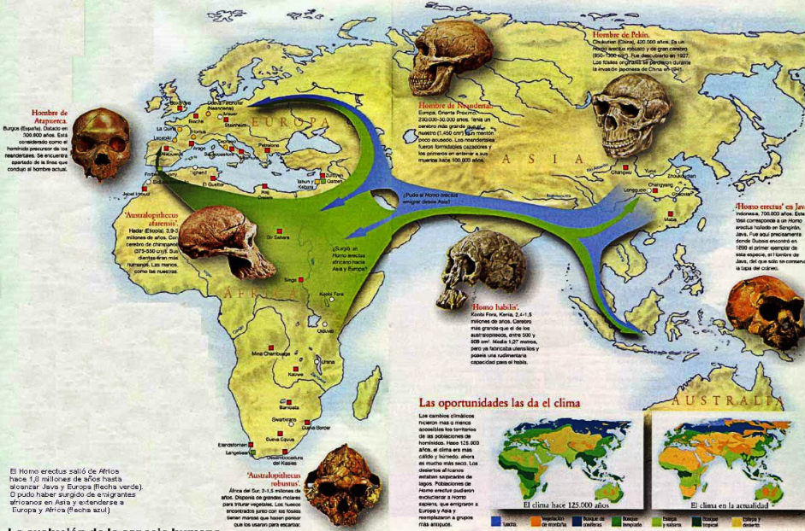
Learning Aim: Describe migration patterns and distribution for Homo erectus.

Slide 12
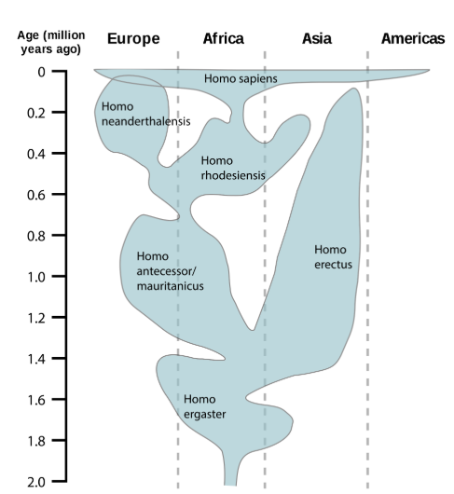
Migration patterns over time of Homo species
Learning Aim: Describe migration patterns and distribution for Homo erectus.

Slide 13
